Slide 1
Opioid Use Disorders: Impact on HIV
Nora D. Volkow, MD
Director, National Institute on Drug Abuse
National Institutes of Health
@NIDAnews

Slide 2
There are no conflicts of interest to declare

Slide 3
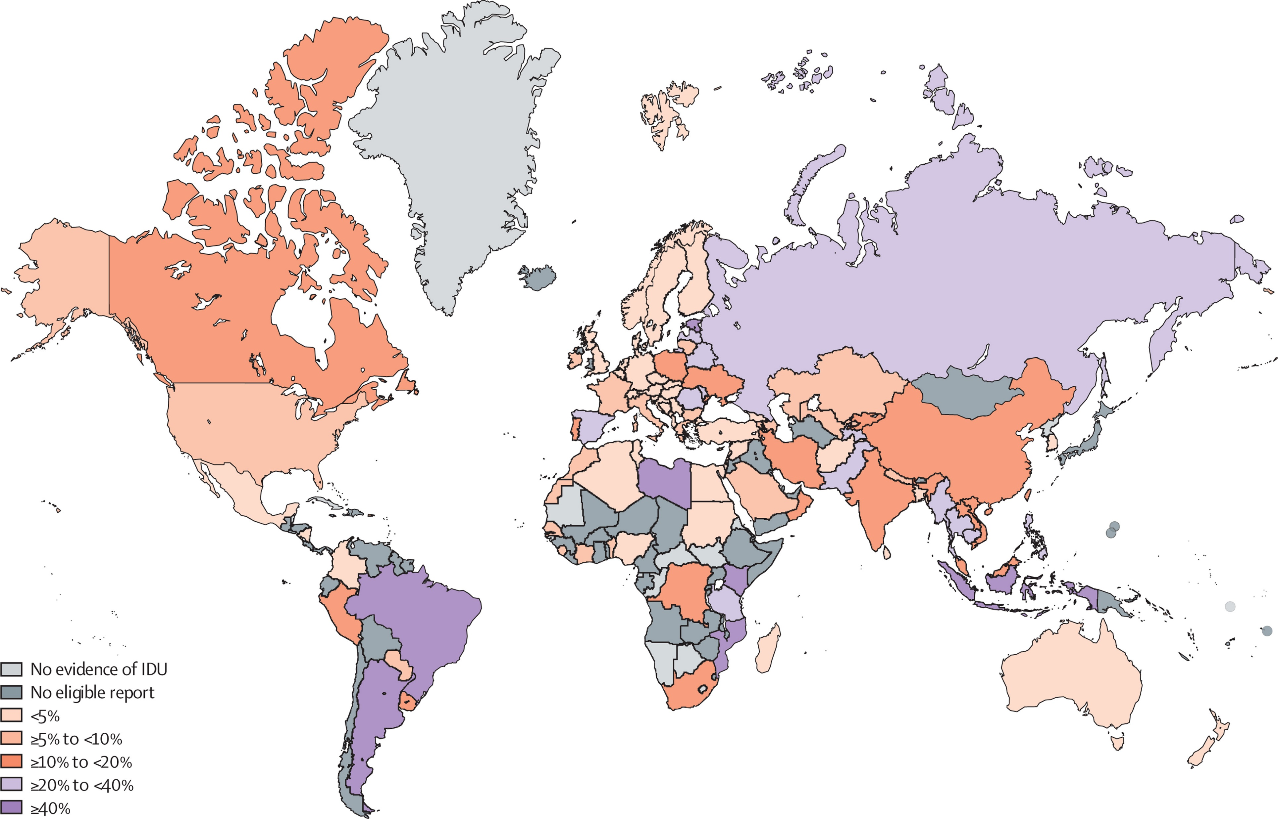
Globally HIV Appears to be Rising Among PWID
Estimated HIV Prevalence Among People Who Inject Drugs (PWID)
Total Population
HIV Incidence (%)
PWID
HIV Incidence (%)
Lancet Glob Health. 2017.
Globally, 13M PWID and 1.7M are HIV+
Globally, 10% of HIV infections are from IDU
WHO: https://www.who.int/hiv/topics/idu/en/
UNAIDS 2018 estimates

Slide 4
US Opioid Epidemic has Increased Overdose Deaths and Prevalence of PWID
Overdose Deaths
1999
In 2017, 70,237 OD Deaths (9.6% higher than 2016)
Prevalence of IDU in US has increased in past 15 years
Heroin IDU in US (12 or older, past-month use)
2016
Β Coefficient: 0.1519
Ƿ Value for the trend: <0.0001
https://www.cdc.gov/nchs/data-visualization/drug-poisoning-mortality/index.htm
Year
Han et al., SAMHSA (unpublished)

Slide 5
U.S. counties vulnerable to rapid spread of IDU-associated HIV
HIV Can Spread Rapidly Among People Who Inject Drugs
220 counties in 26 states
King County, WA. 27 HIV cases from IDU in 2018. (286% from 2017)
Van Handel et al., J Acquir Immune Defic Syndr. 2016
Cabell County WV, 55 HIV Cases from IDU in 2019 (588% increase from 2016)
Scott County, IN 215 HIV cases from IDU in 2014-2015
Multnomah County, OR. 42 HIV cases mostly IDU in 2018-2019. (200% increased from 2016-2017)
Lowell and Lawrence, MA, 129 HIV cases in IDU from 2015-2018 (2012-2014, entire Mass had 123 IDU cases).
Philadelphia, PA, 59 HIV Cases from IDU in 2018 (60% increase from 2016)
Northern KY, 280% increase in HIV cases from IDU in 2017
Estimates of HIV increases in IDU are from local newspapers (search Volkow et al., 2019)

Slide 6
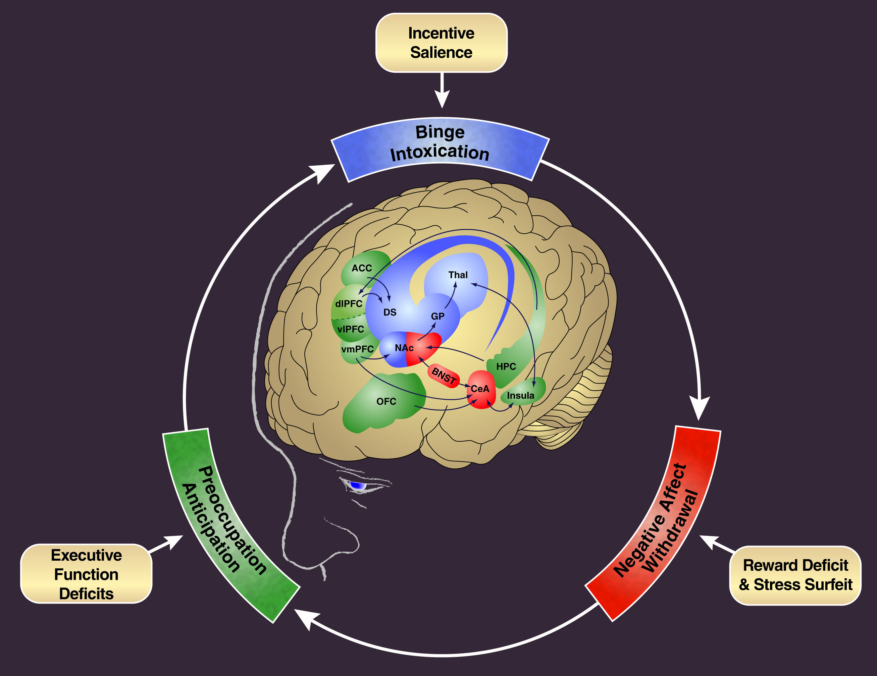
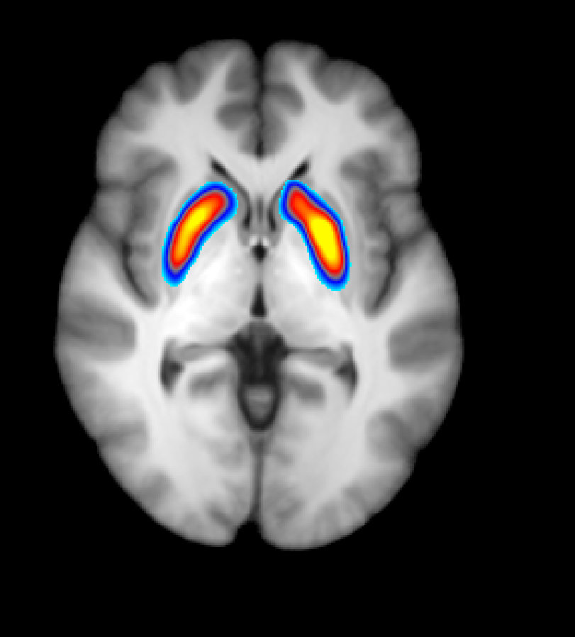
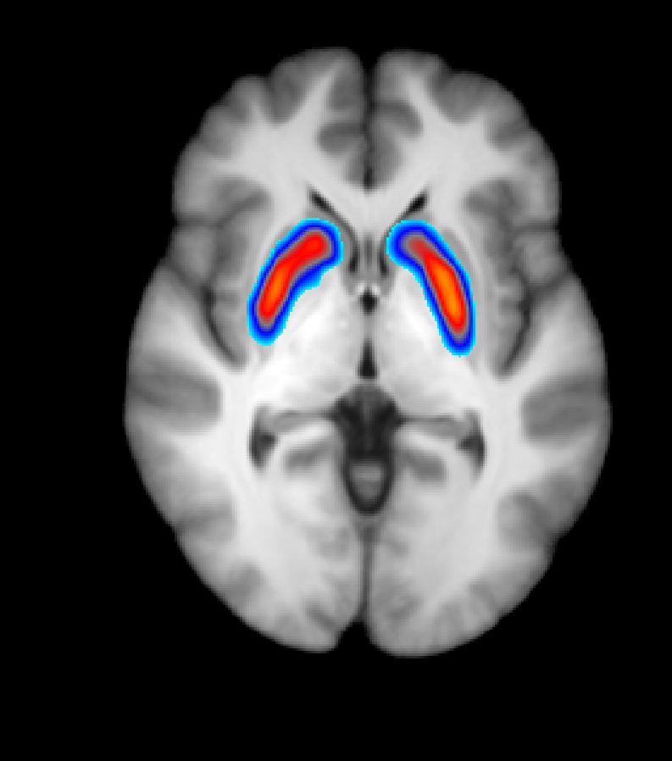
Addiction is a Disease of the Brain
Control
Addicted
Low
High
Healthy Controls
Heroin Addicted Patients
Reduced Dopamine Signaling
Reduced Function of Frontal Cortex
Volkow et al., PNAS 2011
Koob, GF and Volkow ND, Neuropsychopharmacology Reviews 2010

Slide 7
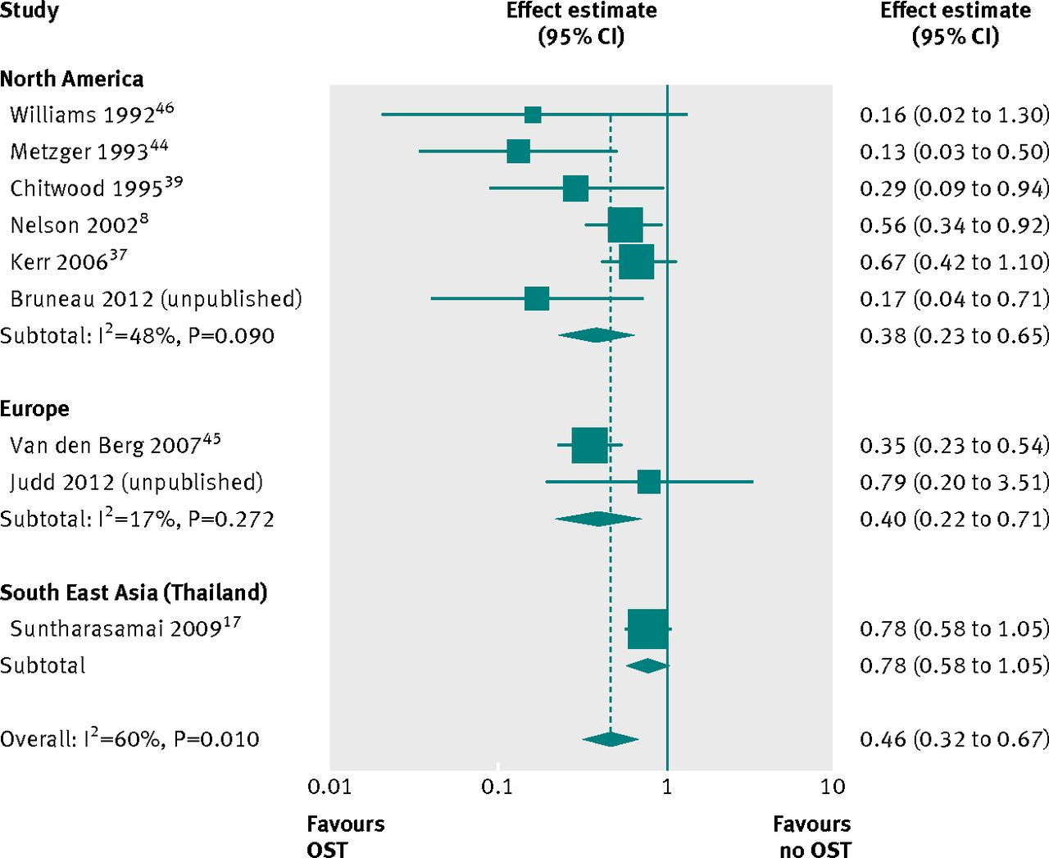
Addiction Can Be Treated
Medications for Opioid Use Disorders (MOUD or MAT, OST)
Impact of MOUD on HIV Transmission
Opioid Effect
Full Agonist
(Methadone: Daily)
Partial Agonist
(Buprenorphine: 3x/week, ER 1 month)
Antagonist
(Naltrexone: ER 1 month)
Log Dose
DECREASES:
Opioid use
Opioid overdose deaths
Criminal activity
HIV and HCV transmission
INCREASES
Social functioning
Retention in HIV treatment
Improves HIV Outcomes
MOUD reduced HIV infections by 54%
MacArthur GJ et al. BMJ 2012

Slide 8
Effects of MOUD on Viral Suppression
Treating Opioid Use Disorders in PLWH
MOUD Improves uptake and retention in ART
69% increased recruitment to ART
Two-fold increase in ART adherence
45% increase in odds of plasma viral suppression (VS)
Lou et al., Clin Infect Dis. 2016

Slide 9
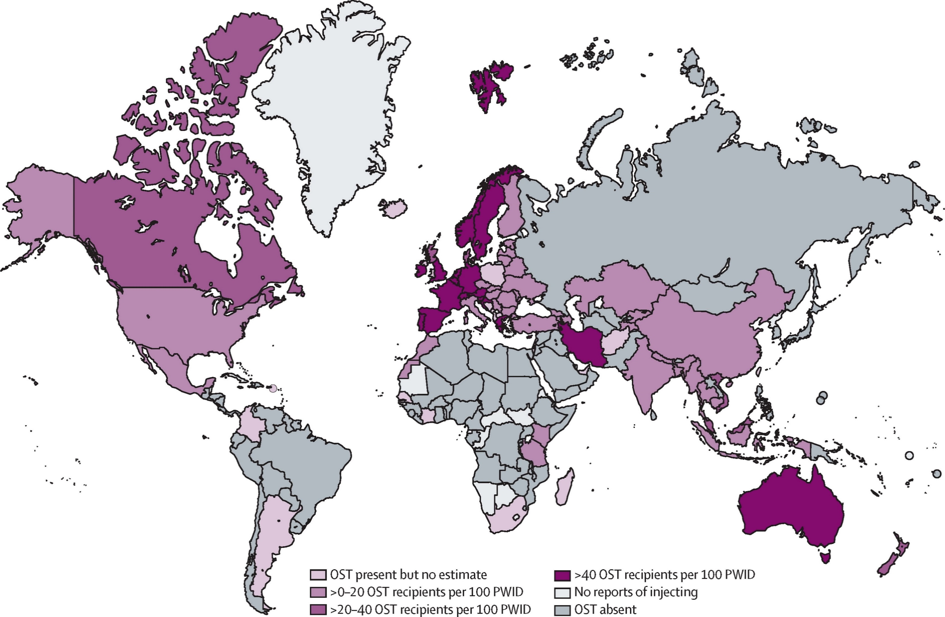
Medications for OUD are Highly Underutilized and Retention is Poor
MOUD Coverage among PWID
OUD Cascade of Care, USA
Larney S et al., Lancet Global Health 2017
Williams et al. Health Affairs Blog, 2017

Slide 10
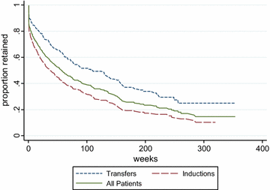
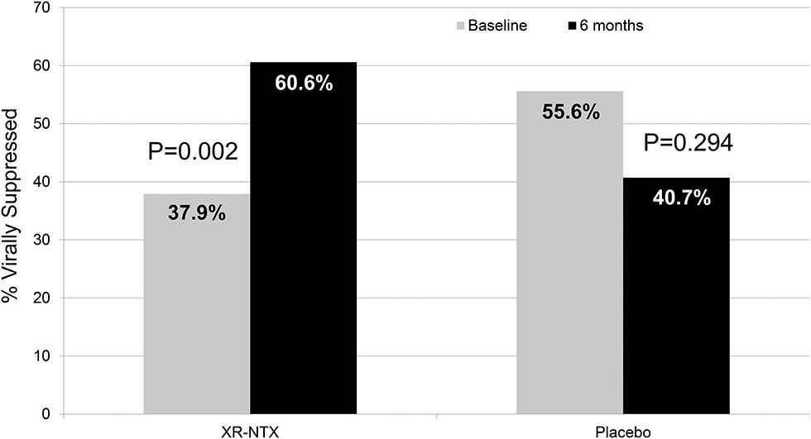
Implementing MOUD in Healthcare Settings
Implementing MOUD in Jail/Prisons
Primary Care: Low Threshold Office-Based Buprenorphine Treatment
PLWH w OUD, are disproportionately incarcerated
HIV prevalence is 3X that in community
VS achieved during incarceration is lost from low linkage to HIV care, relapse and homelessness post-release
Unobserved induction,
At most weekly visits,
No psychosocial treatment
Treatment retention at 38 weeks equivalent to specialized treatment.
XR-NTX given 1w prior to jail release with subsequent injections in community improved VS at 6m Post-release
Bhatraju EP et al., Addict Sci Clin Pract. 2017
Springer SA et al., JAIDS 2018

Slide 11
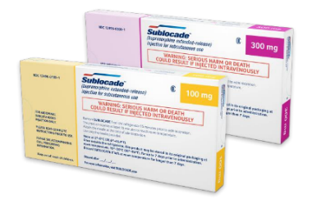
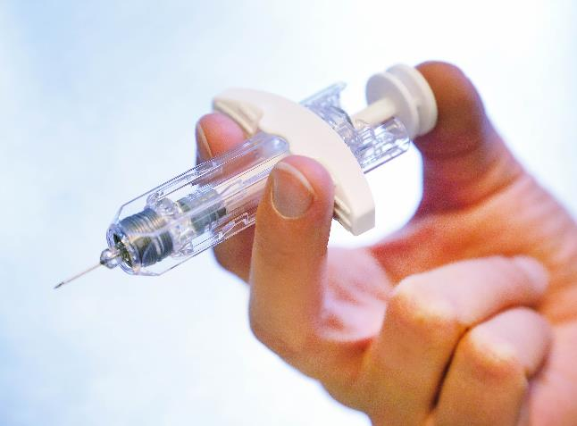
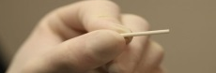
Extended Release (ER) Formulations Facilitate Use in Health Care & Justice Settings and Improve Compliance
Mu Antagonist: NALTREXONE
Mu Partial Agonist: BUPRENORPHINE
Vivitrol®
Once-month Injection
SUBLOCADE™
(Buprenorphine ER),
Once-Month Injectable
FDA Approval 11.30.2017
Median % Opioid-Negative Urines for 24 weeks
100%
80%
60%
40%
20%
0%
CAM2038
Subcutaneous Buprenorphine ER:
Once-Week Injection
Once-Month Injection
Percent of Weekly Urine Tests
PROBUPHINE®
PLACEBO
ER-NTX
6 months implant
Placebo: N=124
ER-NTX: N=126
Krupitzky et al., Lancet 2011

Slide 12
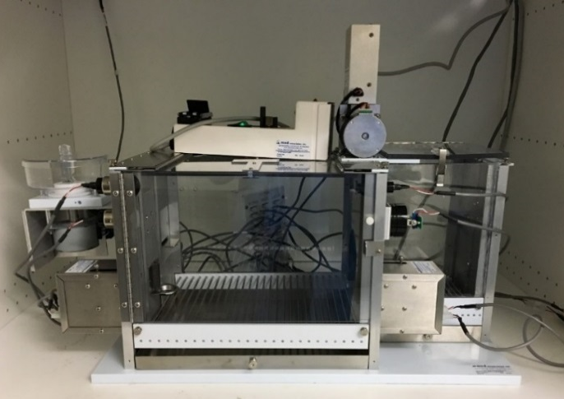
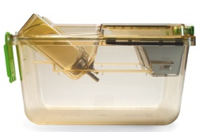
Social Interaction Favored over Heroin Unless Social Interaction is Punished
Sliding
door
Partner
chamber
Resident
self-administration chamber
HEROIN
Drug lever
Social lever
James Nachtwey. TIME Special Report
Venniro et al., Nature Neuroscience 2018

Slide 13
THANKS

